Slide 1

Our English class!

Slide 2
Unit 3: AT HOME
SECTION A: What a lovely home!
Listen. Then practice with a partner.
(English textbook, grade 7: page29-30)

Slide 3
This is Hoa’s house.

Slide 4
Hoa and Lan are in the house. Let’s listen to them.
Hoa
Lan

Slide 5
Vocabulary

Slide 6
awful (adj)
The weather isn’t fine. It’s awful.

Slide 7
Have a seat (exp)
to sit (v)
→ seat (n)
Ex:
Please have a seat.
(Sit down, please)

Slide 8
armchair (n)
He’s sitting in an armchair.

Slide 9
comfortable (adj)
I feel comfortable.

Slide 10
bright (adj)
The sun is bright.

Slide 11
sink
tub
shower

Slide 12
modern (adj)
This car is modern.

Slide 13
amazing (adj)
Wow!!!

Slide 14
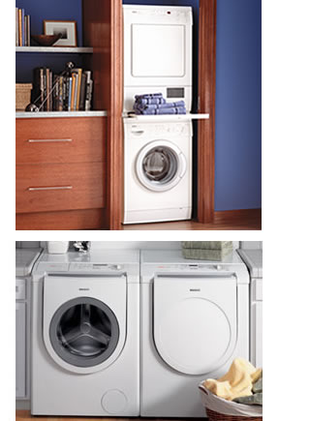
dryer
washing machine
washing machine
dryer

Slide 15
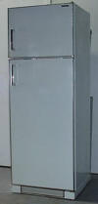
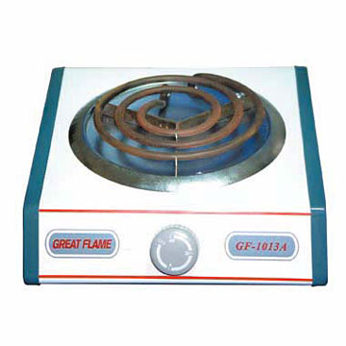
refrigerator
electric stove

Slide 16
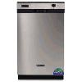
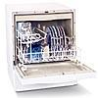
dishwasher

Slide 17
convenient (adj)

Slide 18
Vocabulary
awful (adj):
have a seat, please (exp):
armchair (n) :
Comfortable (adj):
bright (adj) :
sink (n) :
tub (n) :
shower (n) :

Slide 19
Vocabulary
amazing (adj):
convenient (adj):
modern (adj):
washing machine (n):
dryer (n):
refrigerator (n):
dishwasher (n):
electric stove (n):

Slide 20
Hoa
What an awful day! You must be cold, Lan. Come in and have a seat. That armchair is comfortable.
Lan
Thanks. What a lovely living room! Where are your uncle and aunt?

Slide 21
Hoa
My uncle is at work and my aunt is shopping. Would you like some tea?
Lan
No, thanks. I’m fine.

Slide 22
Hoa
- O.K. Come and see my room!
Lan
- What a bright room!And what nice colors! Pink and white. Pink is my favorite color. Can I see the rest of the house?
- Of course.

Slide 23
Hoa
This is the bathroom.
Lan
What a beautiful bathroom! It has a sink, a tub and a shower.

Slide 24
Hoa
Yes, it’s very modern. Now come and look at the kitchen. You’ll love it.
Lan
Wow! What an amazing kitchen! It has everything: washing machine, dryer, refrigerator, dishwasher, electric stove…

Slide 25
Hoa
Yes, it’s very convenient. How about a drink, Lan? Would you like some orange juice?
Lan
What a great idea! I’d love some.

Slide 26
Answer the questions

Slide 27
Question 1:
Which room do Hoa and Lan talk about?
They talk about the living room, Hoa’s room, the bathroom and the kitchen.

Slide 28
Question 2:
Why does Lan like Hoa’s room?
Because it’s bright.

Slide 29
Question 3:
What is in the bathroom?
It has a sink, a tub and a shower.

Slide 30
Question 4:
What is in the kitchen?
It has everything: washing machine, dryer, refrigerator, dishwasher, electric stove…

Slide 31
About you:
How many rooms are there in your house?
What things are there in your room?

Slide 32
Match the adjectives with their meanings
*Checking vocabulary
1. Wet
a. Dở, tệ
2. boring
b. Ẩm ướt
3. interesting
c. Ngon
4. delicious
d. Tẻ nhạt
5. bad
e. Hay, thú vị

Slide 33
What an awful day !
What a bright room !
What nice colors !
What delicious milk !
adj N
*Structures of the exclamation:
a. Danh từ số ít: | What + a/ an + adj + N!
b. Danh từ số nhiều: | What + adj + N (s/es)!
c. Danh từ không đếm được: | What + adj + N!

Slide 34
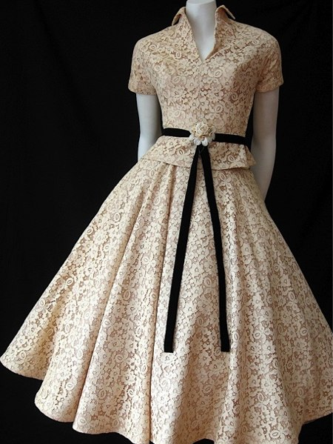
a. Complaints:
Ex: Expensive dress
What an expensive dress !
1. awful restaurant
What an awful restaurant !
2. wet day
What a wet day !
3. boring party
What a boring party !
4. bad movie
800 000đ
What a bad movie !

Slide 35
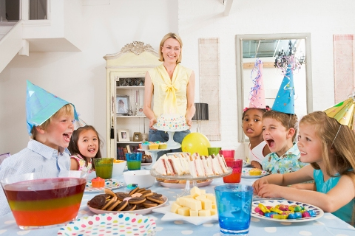
a. Compliments:
Ex: Great party
What a great party !
1. Bright room
What a bright room !
2. Interesting movie
What an interesting movie !
3. Lovely house
What a lovely house !
5. Beautiful day
What a beautiful day !
4. Delicious dinner
What a delicious dinner

Slide 36
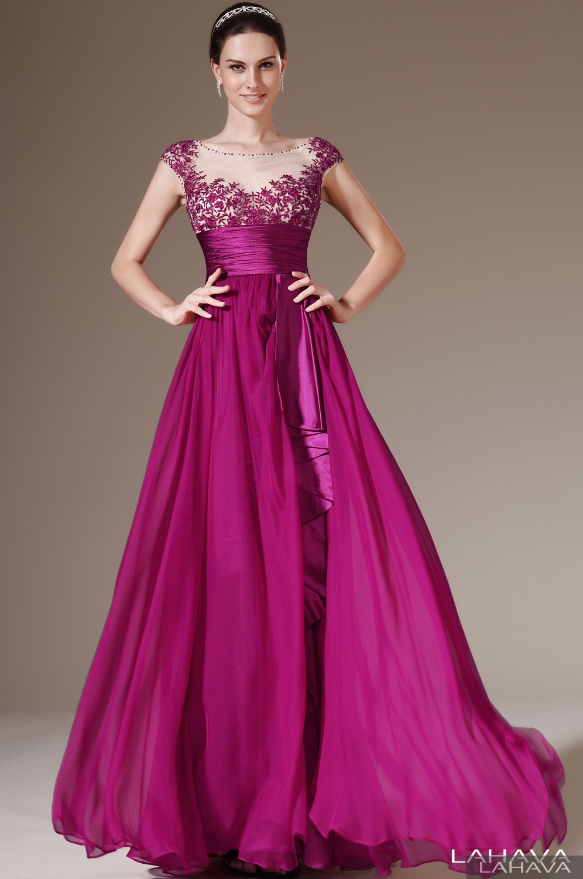
The girl is very beautiful.
What a beautiful girl !

Slide 37
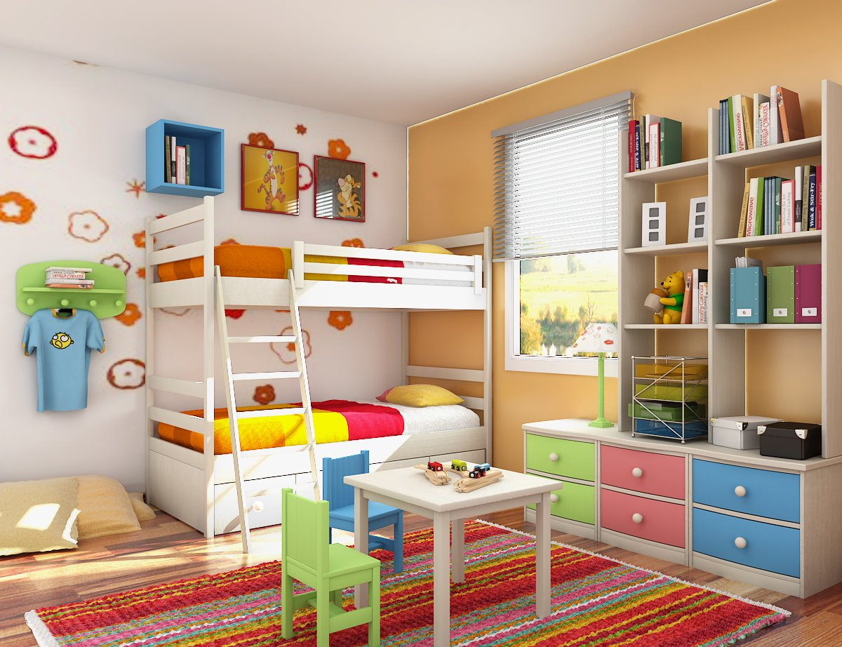
The room is very bright.
What a bright room !

Slide 38
Transforming
Statements | Exclamations
The computer is modern.
The movie is very interesting.
The flowers are sweet.
The houses are beautiful.
The soup is very delicious.
What a modern computer !
What an interesting movie !.
What sweet flowers!.
What beautiful houses !.
What delicious soup !.

Slide 39
REMEMBER
Exclamations | Prepositions of time
What + a/ an + adj + N! What + adj + N (s/es)! What + adj + N! | On At From… to …
HOMEWORK
 Learn by heart vocabulary and structure
 Prepare B

Slide 40



Good bye! See you next time!

